Slide 1



BioMedBuddy
Learn The Human Body With Fun!
An interactive educational website for kids to explore the human body through colorful visuals and quizzes.
By: Kaliphile Papiyana
BioMedBuddy Mascot
01

Slide 2


Challenges Facing High School Students
🧠 Lack of Engaging Science Resources Most biology content is dense, text-heavy, and hard for learners to visualize — especially anatomy.
📱 Too Much Passive Screen Time Many students consume unstructured, non-educational content online, missing out on interactive learning tools.
❌ Limited Access to Quality Tools In low-resource schools, students often don’t have access to colourful diagrams, models, or digital learning platforms.
https://stock.adobe.com/za/search/images?k=confused+student+in+class
10

Slide 3

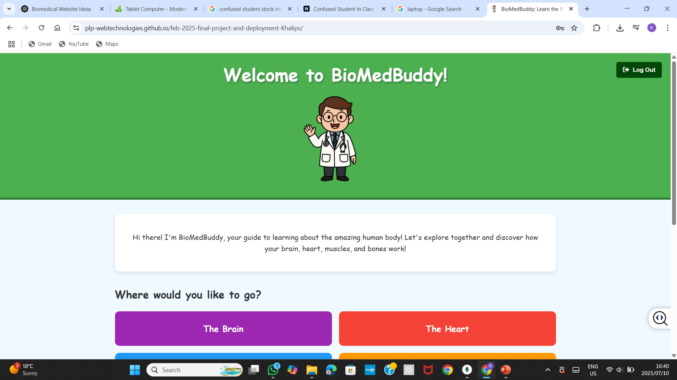

Our Software Solution
✔️A colorful, cartoon-style website that
teaches basic anatomy. ✔️ Pages cover the brain, heart, muscles &
bones. ✔️ Includes interactive quizzes and a
friendly doctor mascot. ✔️ Designed specifically for Primary School
Students
06

Slide 4
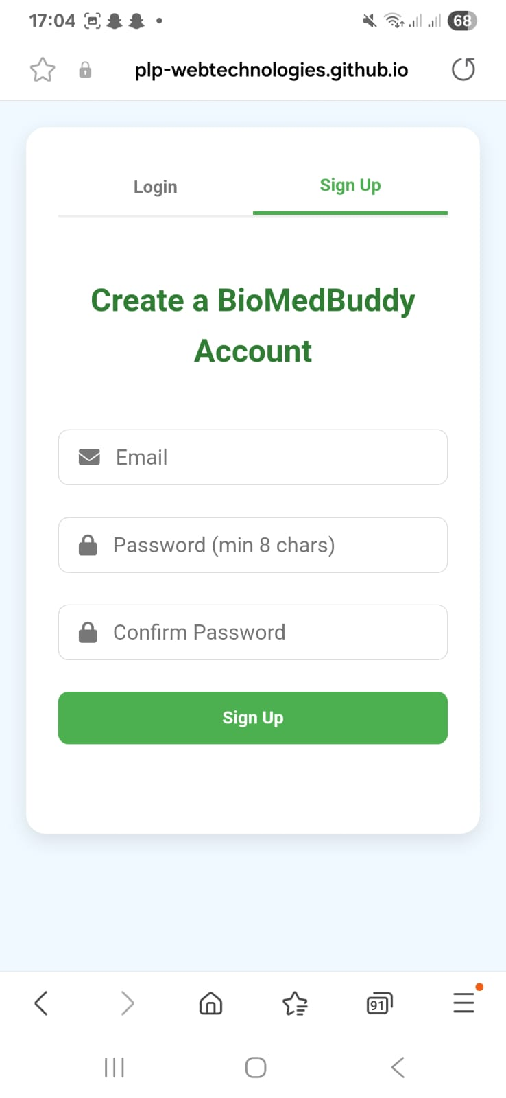
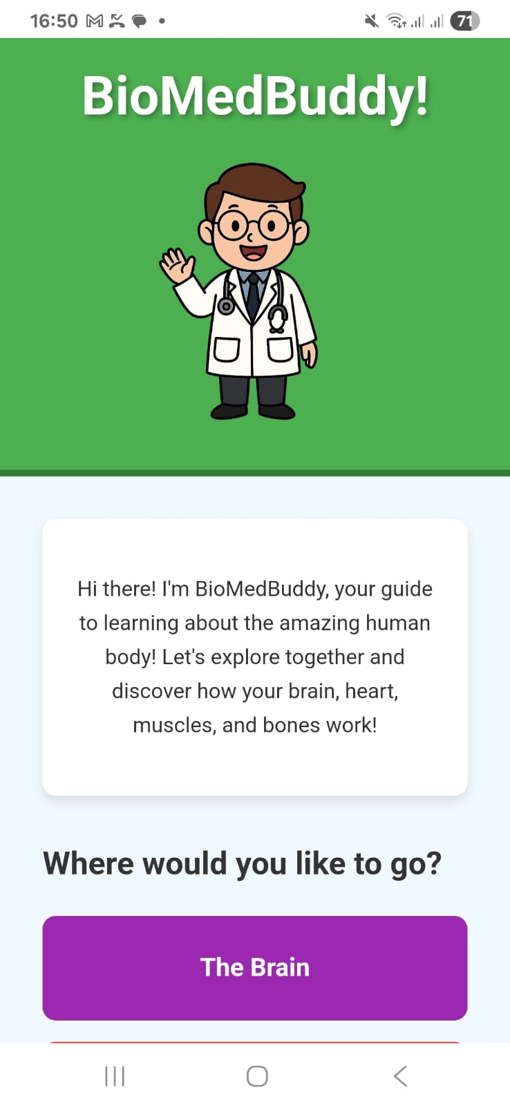
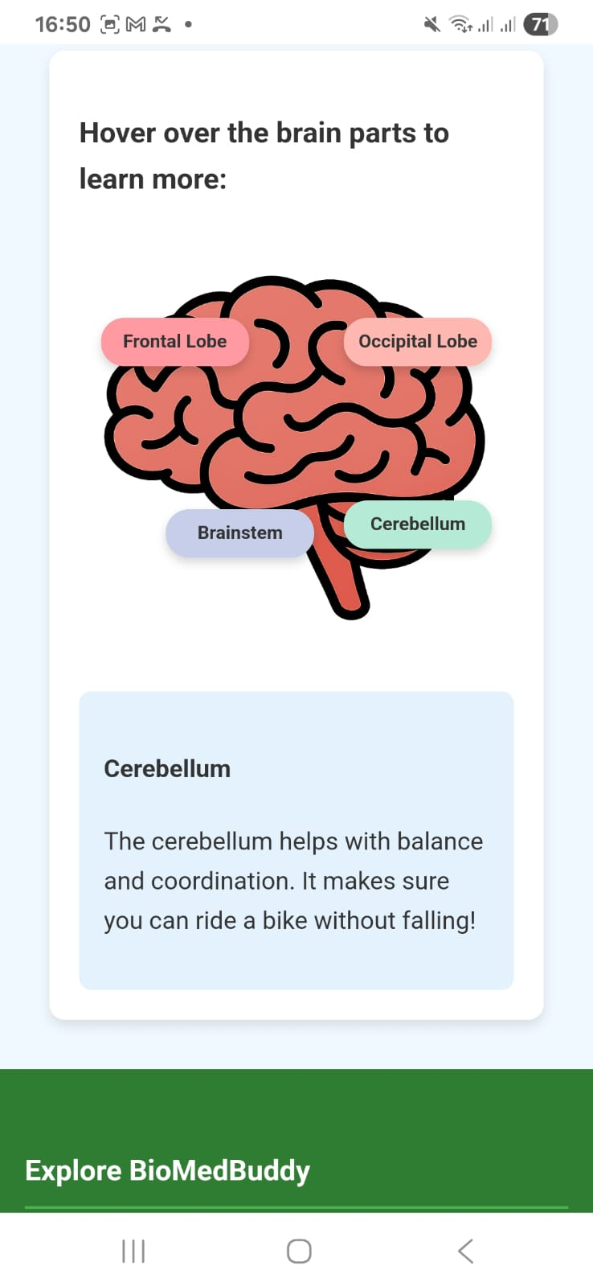
Product: BioMedBuddy
How it Works:
Login Page: Create your BiomedBuddy account
Home Page: Meet the mascot and navigate to each body part.
Body Part Pages: Bright diagrams + fun facts (e.g. brain, heart).
Quiz Page: Short multiple-choice quiz with animated feedback.
Fully Responsive: Works on tablets and phones.
User Friendly Interface: Easy to navigate
04

Slide 5


Target Market
Only 37%
Grade 5 learners in South Africa achieve a “basic science literacy” level (TIMSS 2019) ➡️ Shows the urgent need for early, engaging science tools like BioBuddy.
Over 80%
South African youth aged 10–17 have access to a mobile device at home (Stats SA 2022) ➡️ BioBuddy can reach kids directly through mobile-friendly learning.
Less than R30 per year
Spent per learner per year by South African public schools on digital learning systems (DBE 2023).
➡️ Highlights the lack of investment in visual, interactive resources like BioBuddy.
Sources: 1) https://timssandpirls.bc.edu/timss2019/ 2) https://www.statssa.gov.za/publications/P0318/P03182022.pdf 3) https://pmg.org.za
14

Slide 6
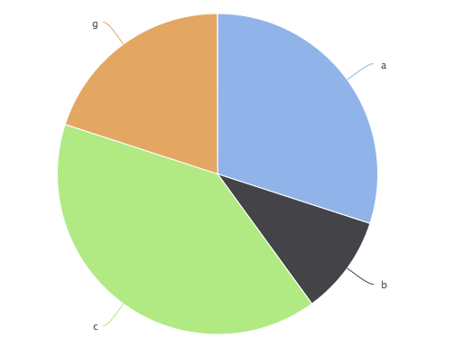
Market Size
STEM NGOs
The platform targets:
Public Primary Schools - Largest reach,
wide need
Homeschooling Parents – Growing post
COVID
STEM NGOs – Partnership for rollout
Private Tutors / Centers – Urban learning
hubs
Homeschooling parents
20%
20%
50%
10%
Private Tutors
Public Primary Schools
Sources: 1) https://www.statssa.gov.za/publications/P0318/P03182022.pdf 2) https://www.unesco.org/reports/global-education-monitoring-report
3) https://www.education.gov.za 4) https://edtechhub.org

Slide 7
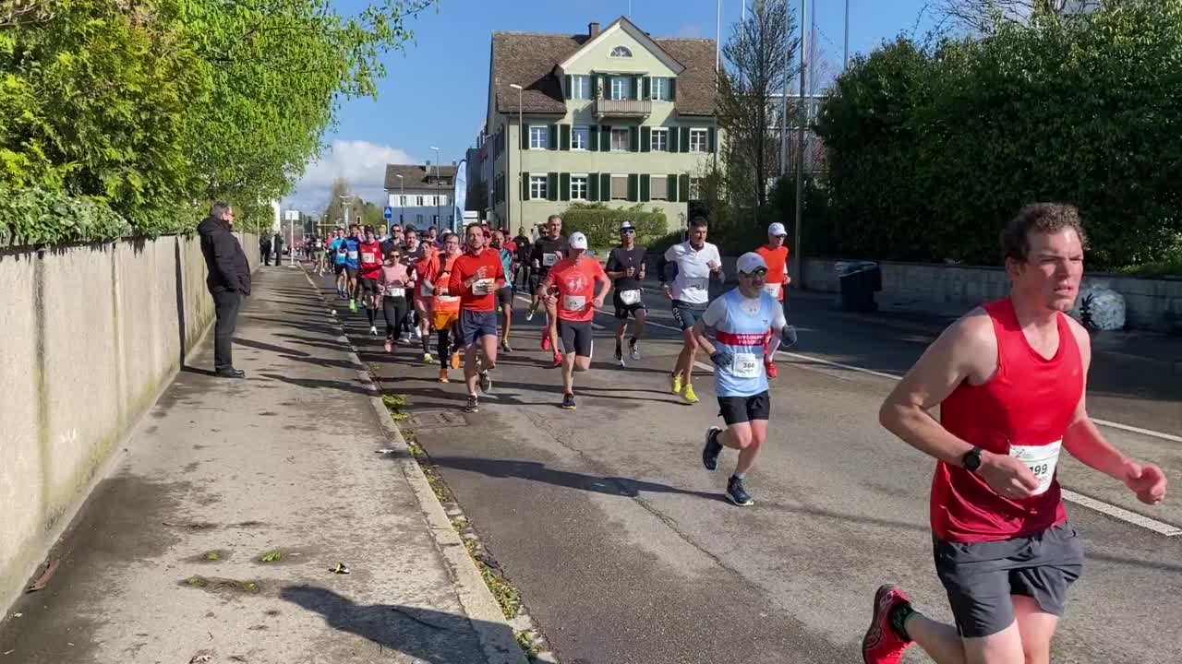
Competitors
Who Else is Out There
Khan Academy Kids
BBC Bitesize
YouTube Science Channels
23

Slide 8

Competitive Advantage
What makes us unique?
1. 🎨 Fun, Science-Aligned Design
Unlike typical sites, BioBuddy uses cartoon-style, color-coded diagrams ii. Follows real anatomy structure while staying kid-friendly and memorable
2. 📱 Mobile-First & Offline Friendly
Designed to work smoothly on phones and tablets (most accessible device for learners)
ii. Printable content for use in schools without reliable internet
3. 🎯 Built for South African Learners
i. Local curriculum-inspired content to support CAPS topics
ii. Can be translated into isiZulu, Sesotho, and isiXhosa to support broader inclusion

Slide 9
Project Traction
Tasks
Month 1
Month 2
Month 3
Month 4
Collect resources or information
Program each web page
Add Quiz Functionality and mobile support
Add Firebase For Authentication
Test with 10+ primary school students
Launch and Improve Based on Feedback
23

Slide 10
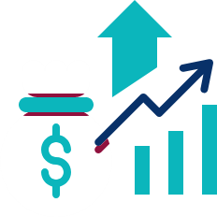
Business Model
Monetization
Software Licenses
🎓 BioBuddy Classroom Edition
One-time license for schools or learning centers
Includes interactive website + printable worksheets
Premium Add-Ons 🧪 Anatomy Expansion Pack – More organs, systems, and animations 🗣️ Multilingual Pack – isiZulu, Sesotho, isiXhosa support 📝 Teacher Dashboard – Track student progress + auto-mark quizzes
Recurring Revenue
🔄 Annual Support Contracts
Includes content updates, new quizzes, and priority support 📥 Content Subscriptions
Monthly themed body systems
Profit Margins
Core System: 60–65% margin
Add-Ons: 70–75% margin
Support Services: 70% margin
23

Slide 11
Go To Market
Getting BioBuddy Out There
Partner with primary schools & teachers
2. Share in biomedical outreach events
3. Collaborate with STEM-focused NGOs
4. Use animated videos on YouTube/Instagram for awareness

Slide 12



Social Impact
🧠 SDG 4: Quality Education 📱 SDG 9: Industry, Innovation & Infrastructure 🌐 SDG 10: Reduced Inequalities

Slide 13
Our Ask
Seeking R10000 seed funding to:
Develop additional content (lungs, digestive system)
Translate into isiZulu and isiXhosa
Pilot with 3 local schools
This funding should sustain operations for 1 year

Slide 14
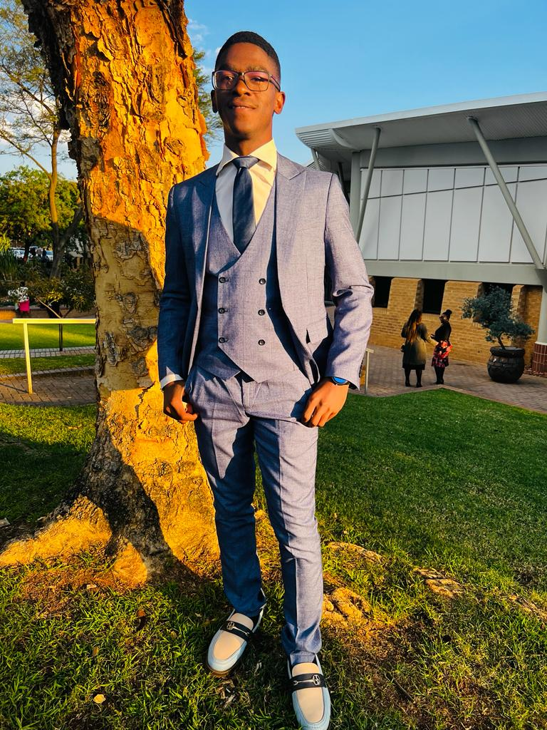
Team Members
KALIPHILE PAPIYANA
Founder/Director

Slide 15




Thank you!
Contact Us:
📧 khaliphilepapiyana7@gmail.com
LinkedIn
https://www.linkedin.com/in/kaliphile-papiyana-b84985264/
17

